Slide 1


FON Tutorial-Neuronal Circuits
Tutorial
Dr Li Yueming

Slide 2
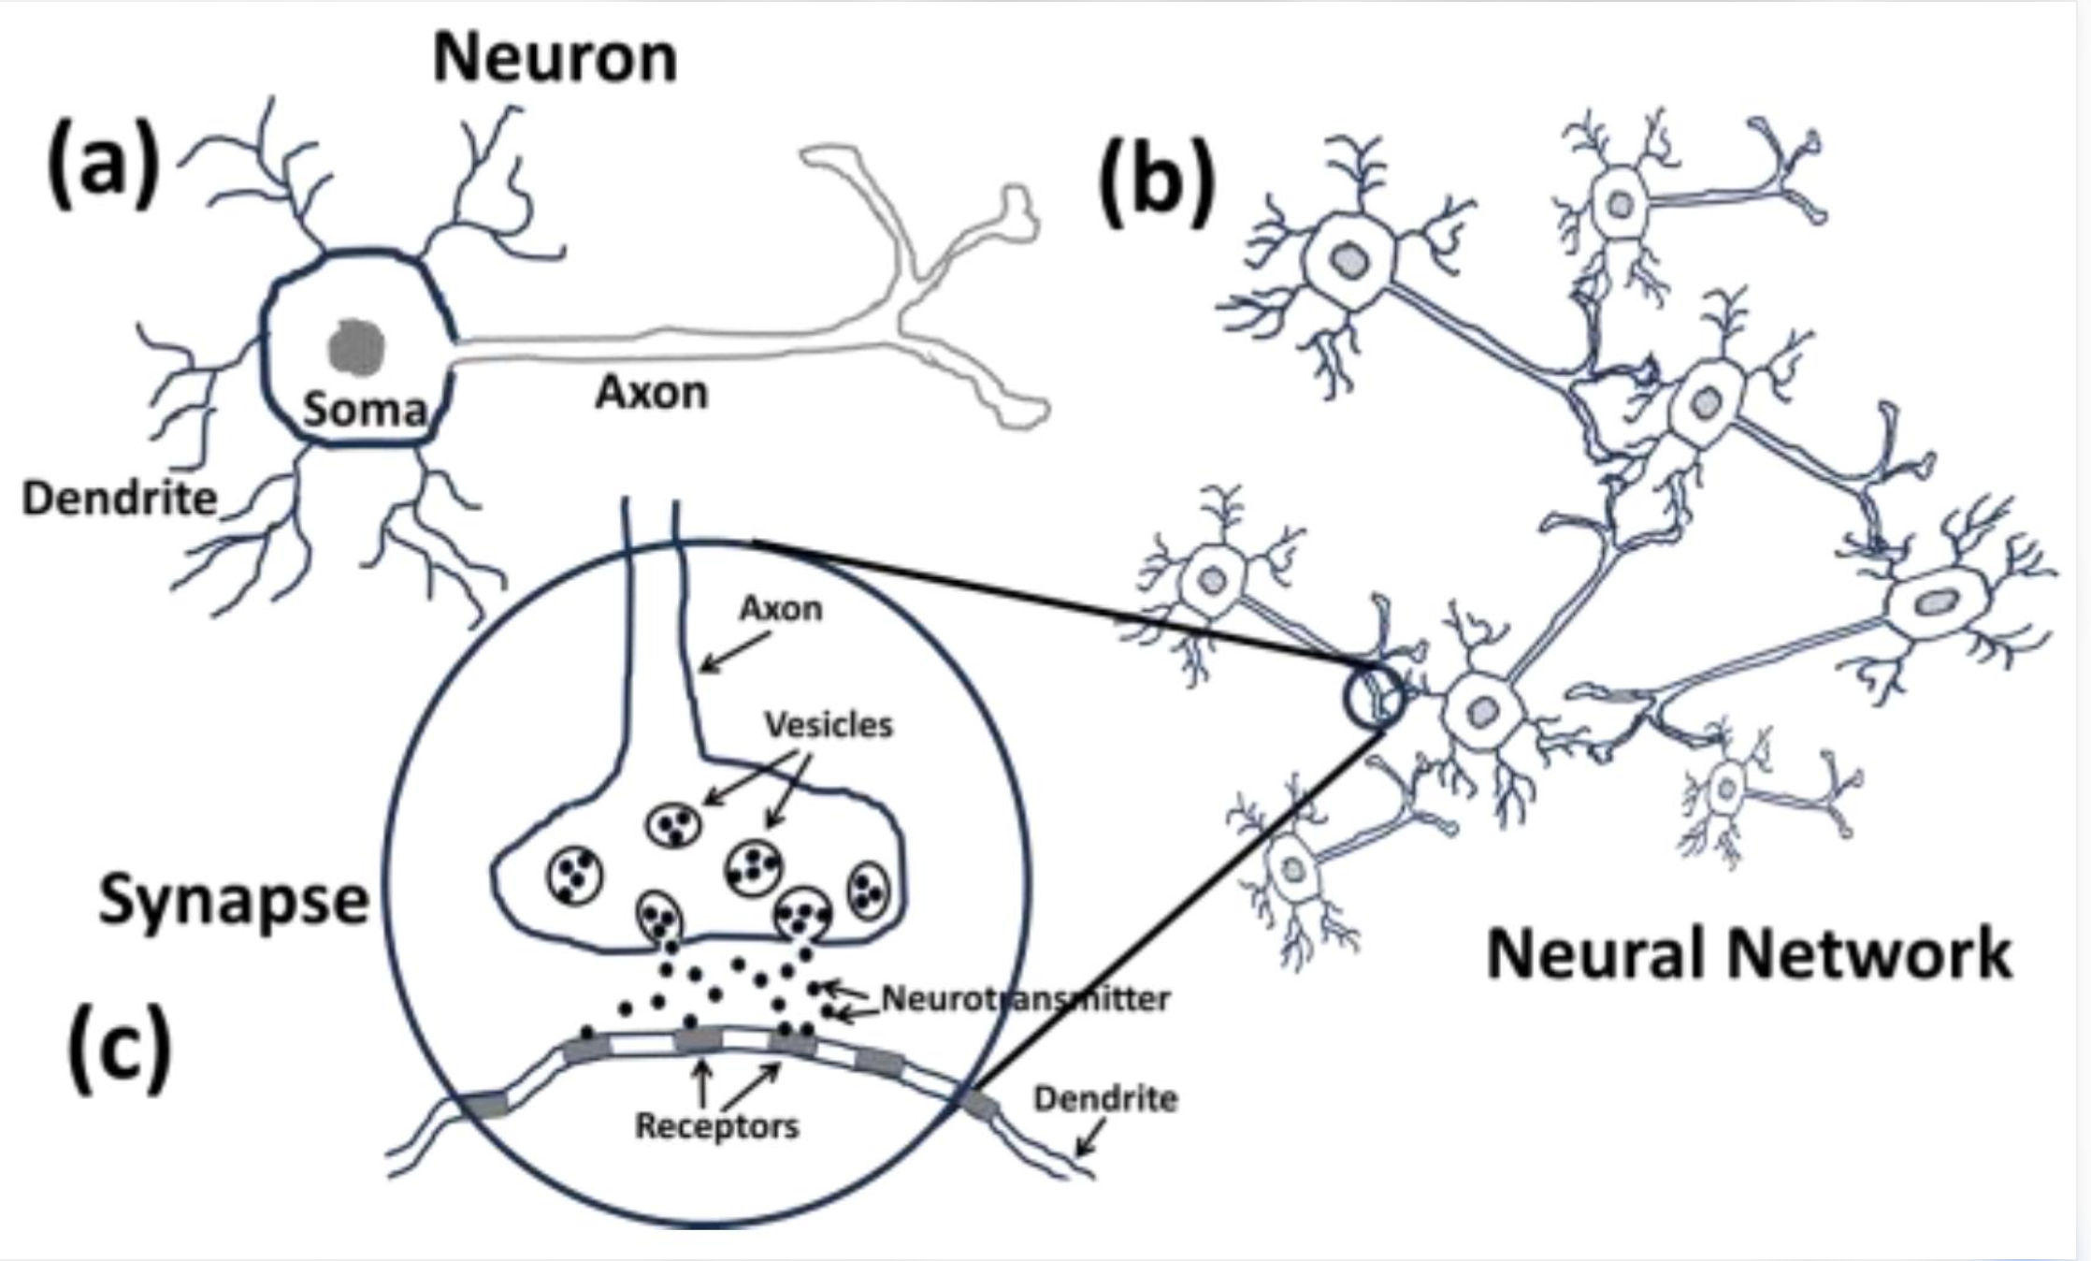
Neuronal Circuits: From Synapses to Network Activity
How do synaptic inputs shape neuronal activity?​
Learning outcomes:
Recognise excitatory and inhibitory inputs
Predict changes in neuronal activity
Understand integration, disinhibition and feedback
  Think about relationships, not individual neurons

Slide 3
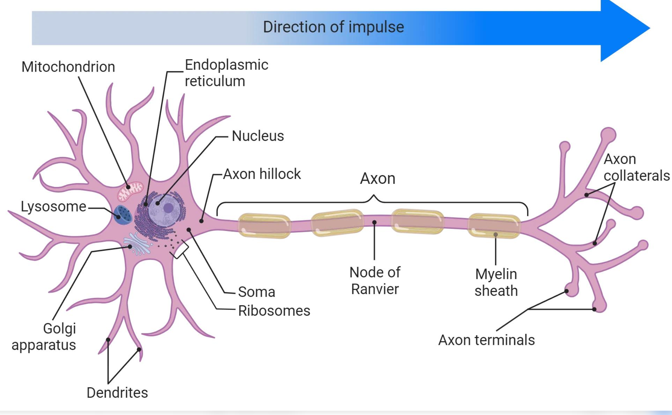
What Controls Neuronal Activity?
A neuron's activity depends on:
1. Synaptic inputs
excitatory input → tends to increase activity
inhibitory input → tends to decrease activity
2. Intrinsic properties
ion channels
spontaneous / ongoing activity
3. Current state of the neuron
  Neurons are not simple ON/OFF switches.

Slide 4
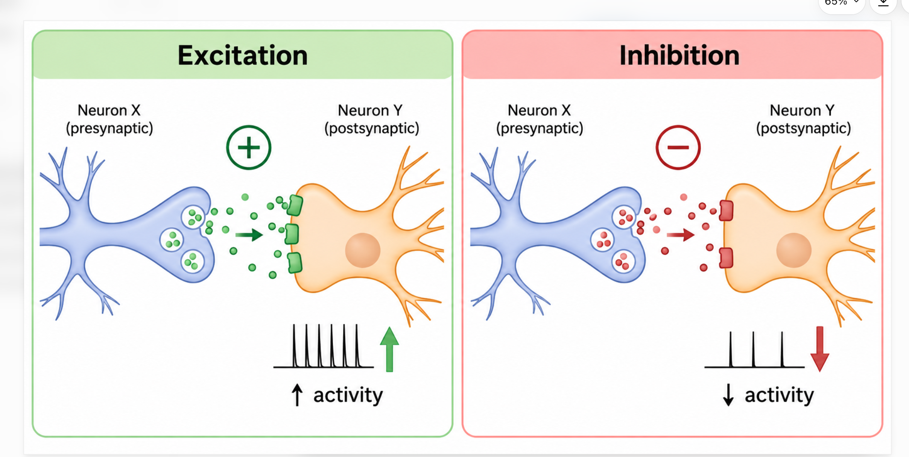
Excitation and Inhibition
Excitatory input
Excitation → increases the probability of firing
Often associated with:
depolarisation → closer to threshold
Inhibitory input
Inhibition → decreases the probability of firing
Often associated with:
reduced excitability → further from firing
  Always identify the sign of each connection first: + or −

Slide 5
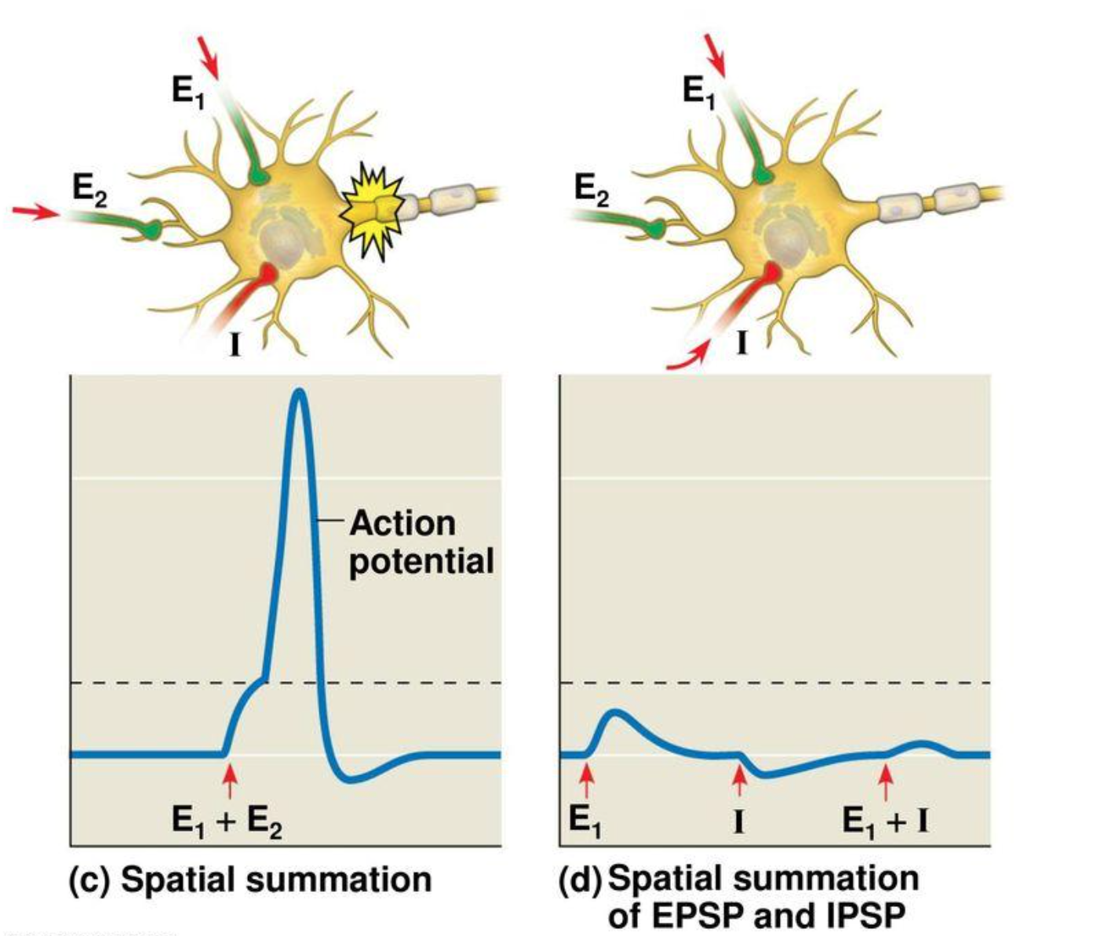
Neurons Integrate Multiple Inputs
Synaptic Integration
A neuron may receive many inputs at the same time.
The neuron integrates:
Excitatory influences
Inhibitory influences
Intrinsic activity
↓
Net effect on firing
Ask:
  What is the overall influence on the target neuron?

Slide 6
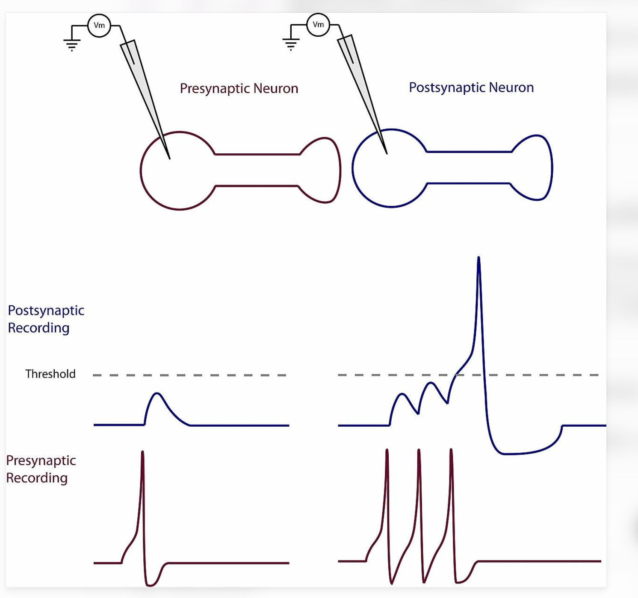
Initial State Matters
Always check the starting state
Is the neuron initially...
Inactive? Or already firing?
An input may:
start activity
increase activity
decrease activity
stop activity
produce little obvious change

Slide 7
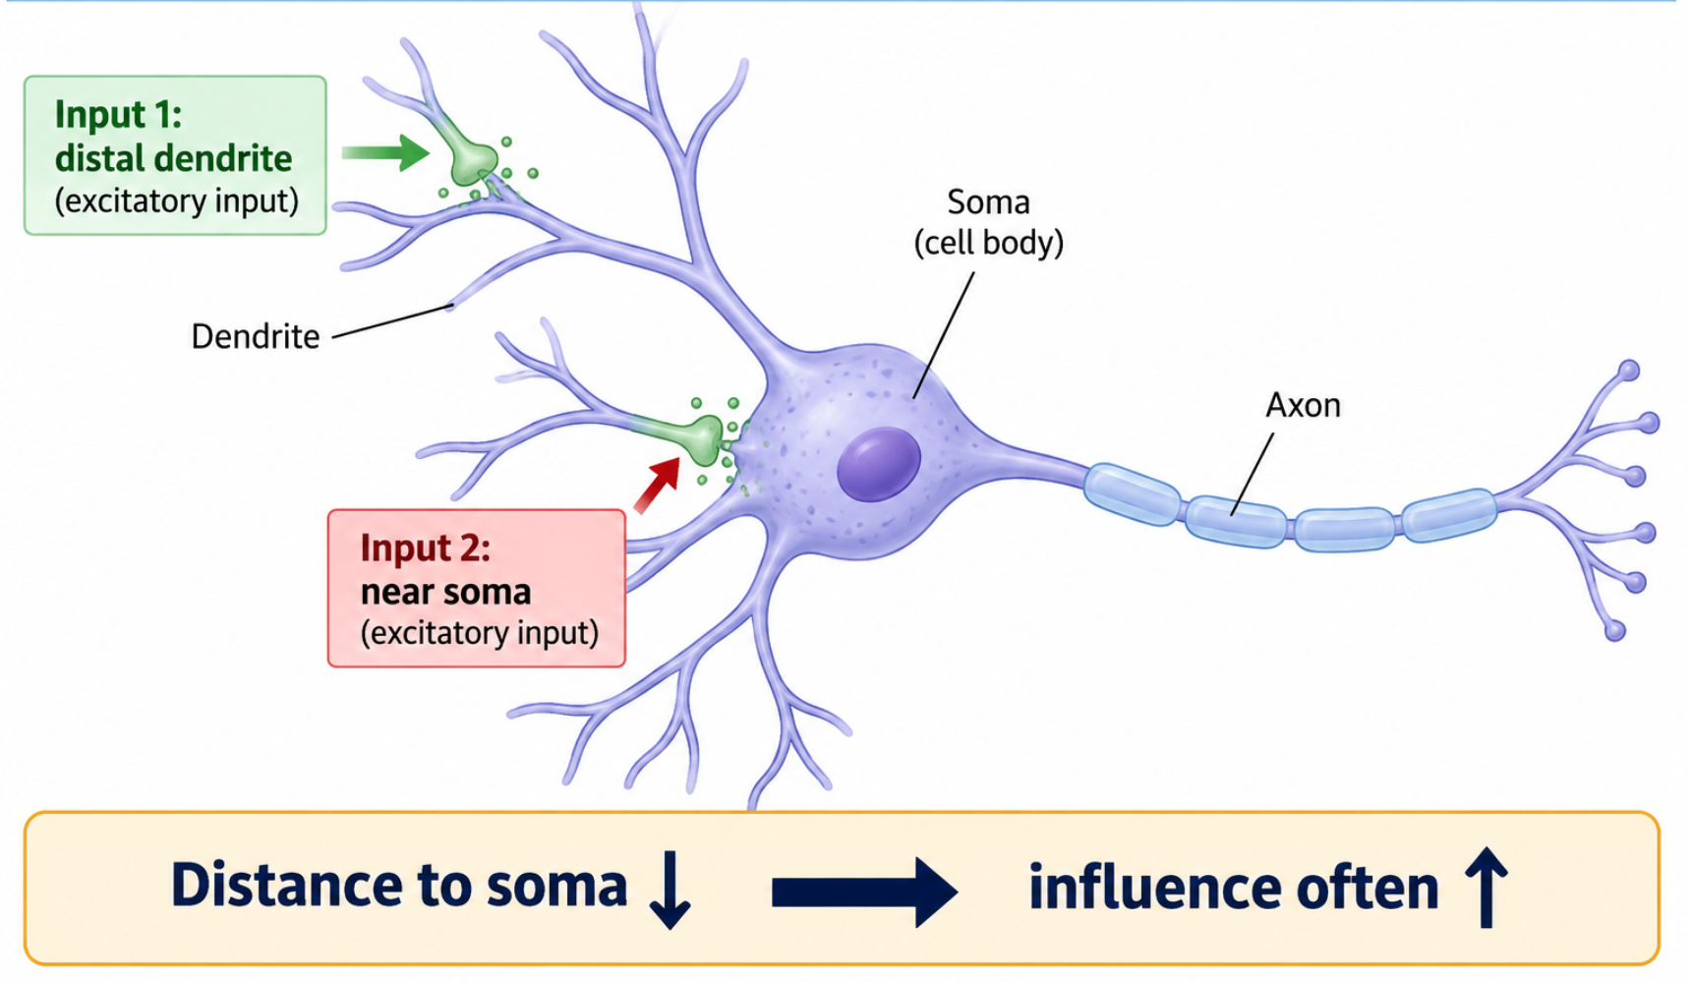
Not All Synaptic Inputs Have the Same Impact
Location matters
The effect of a synaptic input depends partly on where it arrives.
General principle: Inputs closer to the soma often have a greater influence on neuronal output.
But synaptic impact also depends on:
synaptic strength
timing
other active inputs
membrane properties
Notes:
没说就不讲strengt的问题

Slide 8
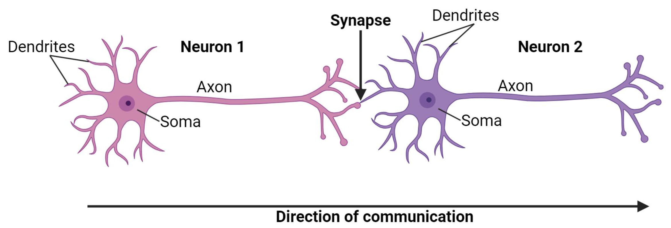
Think One Connection at a Time
Follow the pathway step by step
When one neuron changes:
Step 1 Identify its direct target.
↓
Step 2 Is the connection excitatory or inhibitory?
↓
Step 3 Predict the change in the target.
↓
Step 4 Continue to the next connection.
Neuron P → Neuron Q ┤ Neuron R
  Do not jump directly from the first neuron to the last neuron.

Slide 9
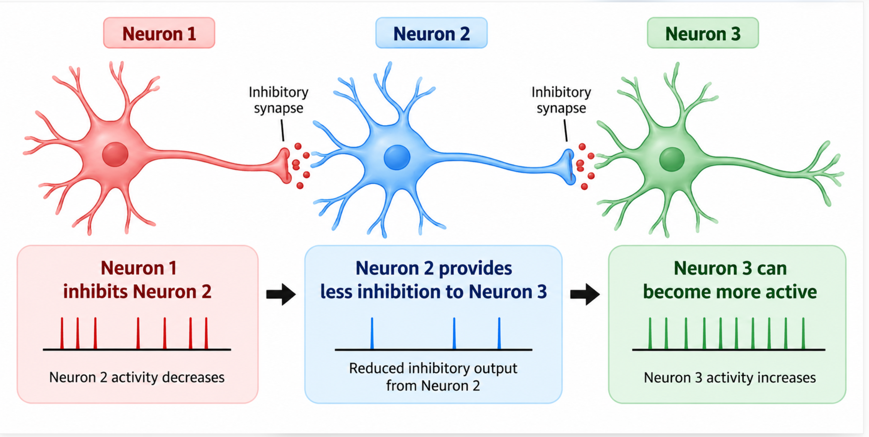
Disinhibition: Inhibiting an Inhibitor
Inhibiting an inhibitory neuron can increase activity downstream.
Inhibition of inhibition → disinhibition
Visual logic:
1 ┤ 2 ┤ 3
If 1 becomes more active:
2 activity ↓
↓
inhibition of 3 ↓
↓
3 activity may ↑
Disinhibition = removal or reduction of inhibition

Slide 10
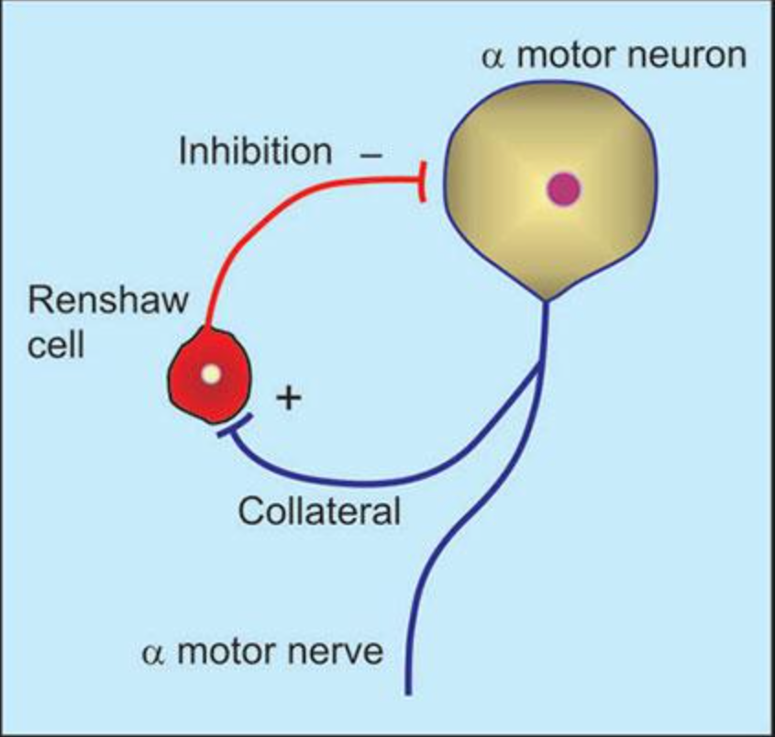
Feedback Changes the Network
Feedback Circuits
Sometimes neuronal activity returns to influence an earlier part of the circuit.
Feedback can:
regulate network activity
reduce excessive activity
maintain or modify ongoing activity
Two useful ideas:
Feedforward: information moves onwards
Feedback: activity influences an earlier stage

Slide 11
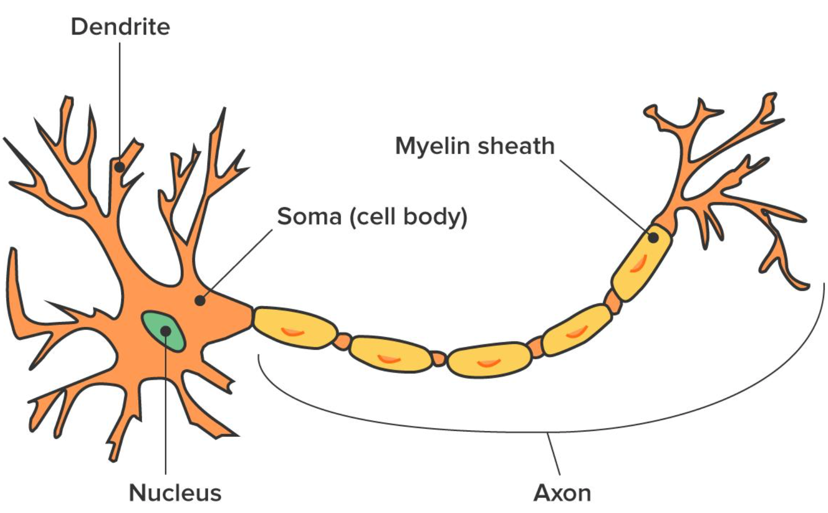
Your Circuit Analysis Toolkit
How to Analyse a Neuronal Circuit
1. Check the starting state Who is active? Who is inactive?
2. Identify each connection Excitatory (+) or Inhibitory (−)?
3. Start with the neuron that changes
4. Follow the pathway step by step
5. Consider all relevant inputs What is the net effect?
6. Look for indirect effects Disinhibition? Feedback?
7. Describe a change in activity
↑ more active | ↓ less active | ↔ little/no change
  Explain WHY — do not only state what happens.

Slide 12

Questions

